Slide 1



"Al-Driven Prediction Model for Car Pricing and Classification Based on Features and Market
Name: Hisham Ahmed Refaat
ID:221035
Name :Mostafa Hesham
ID:220367
Supervisor: Dr Mohamed Labib

Slide 2
Introduction
The automotive industry is evolving, and with the growing number of vehicles on the market, accurately assessing car values has become increasingly important. Traditional methods of determining car prices, such as manual evaluations and dealership assessments, are time-consuming and often subjective.
This project aims to provide a more efficient and data-driven solution by leveraging web scraping, machine learning, and image recognition technologies to predict the price of cars based on detailed information or even by analyzing an image of the vehicle.

Slide 3
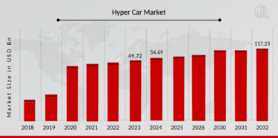
Motivation
In Egypt last 2 year his been change a lot increase in the price
Digital Transformation in Automotive Sales

Slide 4
Problem Statement
The problem of inaccurate and outdated car price predictions is addressed by developing an AI-based pricing model that uses real-time web data.
The problem of incomplete car information is solved by creating an image recognition system to classify cars and predict prices based on photos.
The need for a user-friendly solution is met by developing a website interface for easy access to the car pricing and classification system.

Slide 5
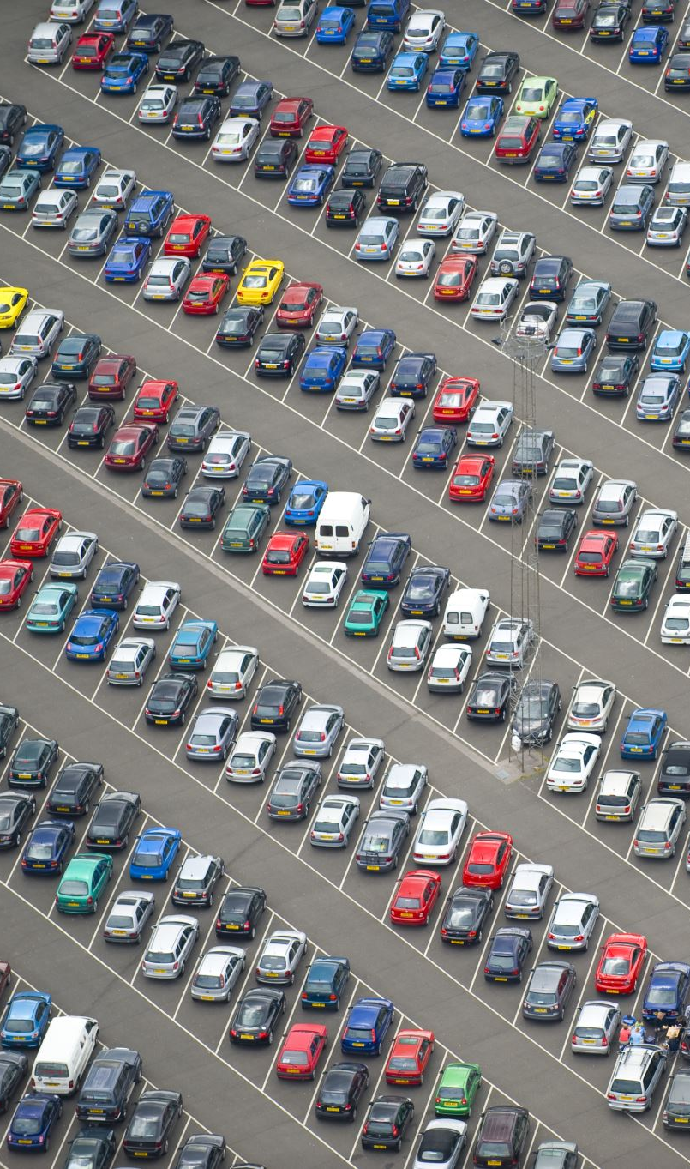
Objective
Automate Car Price Estimation:
Create a machine learning model that predicts car prices based on various features such as make, model, year, mileage, and condition, addressing the need for accurate, real-time car valuations.
Implement Web Scraping for Real-Time Data
Scrape car information (prices, models, features) from various online sources to build a comprehensive dataset, ensuring the model reflects up-to-date market trends
Deliverables
AI-Based Price Prediction Model
Web Scraping Framework
Image Recognition System

Slide 6
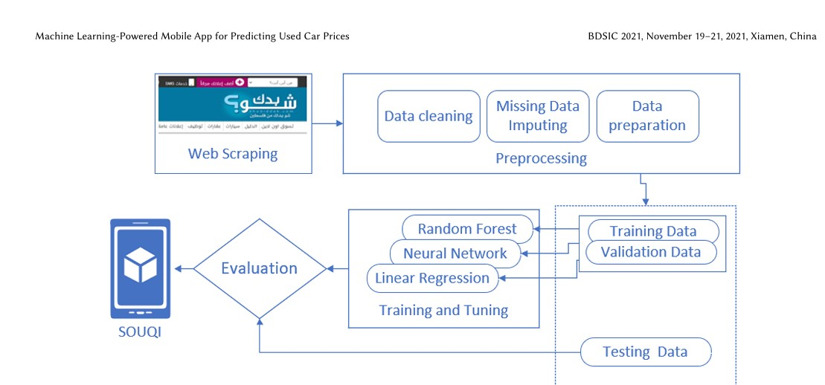
Predictive Analysis of Used Car Prices in Palestine
Main Object:
The research focuses on developing a machine learning-powered mobile app for predicting the prices of used cars.
Dataset:
The dataset includes over 200,000 used car records collected from a popular Palestinian website for used car advertisements.
https://github.com/akramAssi/graduation_projects

Slide 7
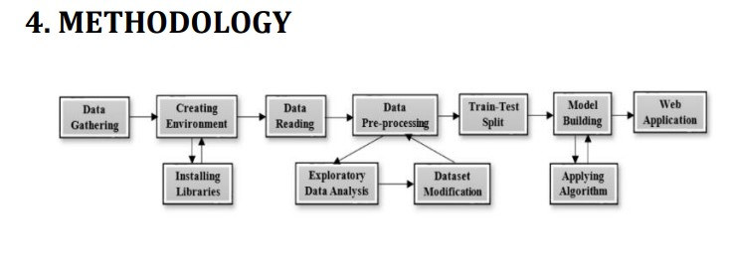
"Prediction of Used Car Prices Using Machine Learning
Main Object:
The research focuses on predicting used car prices using machine learning techniques. The goal is to build models that accurately estimate car prices based on various features such as age, kilometers driven, and fuel type.
The dataset was sourced from Kaggle, containing features such as:
Car name
Year of manufacture
Selling price
Current price
Kilometers driven
Fuel type (diesel, petrol, or CNG)
Seller type (dealer or individual)
Transmission type (automatic or manual)
Number of previous owners

Slide 8
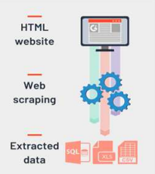
Related Work
dataset get from web scraping
Random Forest accuracy of 89.61%
Gradient Boosted Decision Trees:89.72%
Ridge Regression 86.34%
Data Quality Issues
Limited Feature Set
Image Recognition Scalability

Slide 9

Optional Slides
General Overview
Paper 1 (IRJET):web-based machine learning model
Paper 2 (BDSIC): mobile application
Machine Learning Algorithms Used
Paper 1 (IRJET): Focuses on regression algorithms:
Linear, Ridge, Lasso Regression
Random Forest, Decision Tree, XGBoost, Gradient Boosting
Decision Tree Regression achieved the best performance with an R² score of 0.9544.
Paper 2 (BDSIC): Explores a wider range of algorithms:
Random Forest, Gradient Boosting, ANN, Support Vector Regression (SVR), K-Nearest Neighbors (KNN).
Random Forest was selected for the mobile app due to its superior performance with 89.61% accuracy.

Slide 10
Proposed Solution
Estimation of Second-Hand Car Prices: This paper develops a web scraping platform to collect vehicle data (make, model, year, price) from various websites.
Used Car Price Prediction (Palestinian Dataset): This research scraped over 200,000 used car records and tested multiple machine learning models.
To present a dataset aimed at vehicle make and model recognition using machine learning and deep learning.

Slide 11
Conclusion
Robust Data: Web scraping provided valuable data for analyzing used car prices.
Effectiveness: Web scraping efforts yielded robust data for analyzing used car prices.
to help people to know real price of there cars make it much easer

